Slide 1
Steganography
Lesson 8

Slide 2
LSB

Slide 3
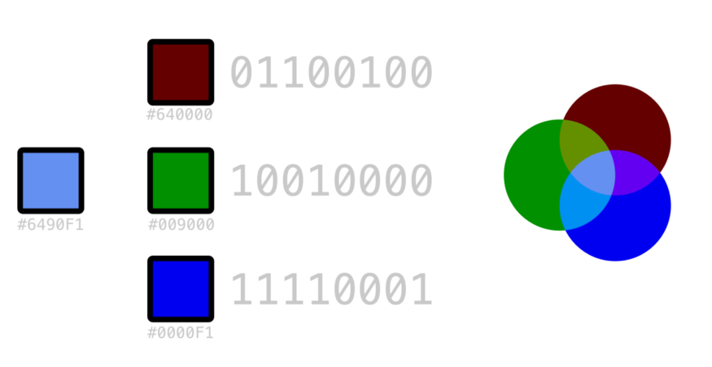
How do photos work?
Each pixel in a photo is represented by a combination of red, green, and blue bytes
1 byte = 8 bits (1s or 0s)
4 bits = 1 Hexadecimal character
To the right is one pixel, which is 011001001001000011110001 in binary or 6490F1 in Hexadecimal
BIT
BYTE

Slide 4
How do photos work?
Each pixel in a photo is represented by a combination of red, green, and blue bytes
1 byte = 8 bits (1s or 0s)
4 bits = 1 Hexadecimal character
To the right is one pixel, which is 011001001001000011110001 in binary or 6490F1 in Hexadecimal
BIT
BYTE

Slide 5
What is lsb?
MSB
LSB
LSB stands for “Least Significant Bit” – it’s the last bit in each byte
LSB steg uses the lsb in each byte to hide a message
If this was the first pixel in our photo, the first 3 bits of our code would be 001

Slide 6
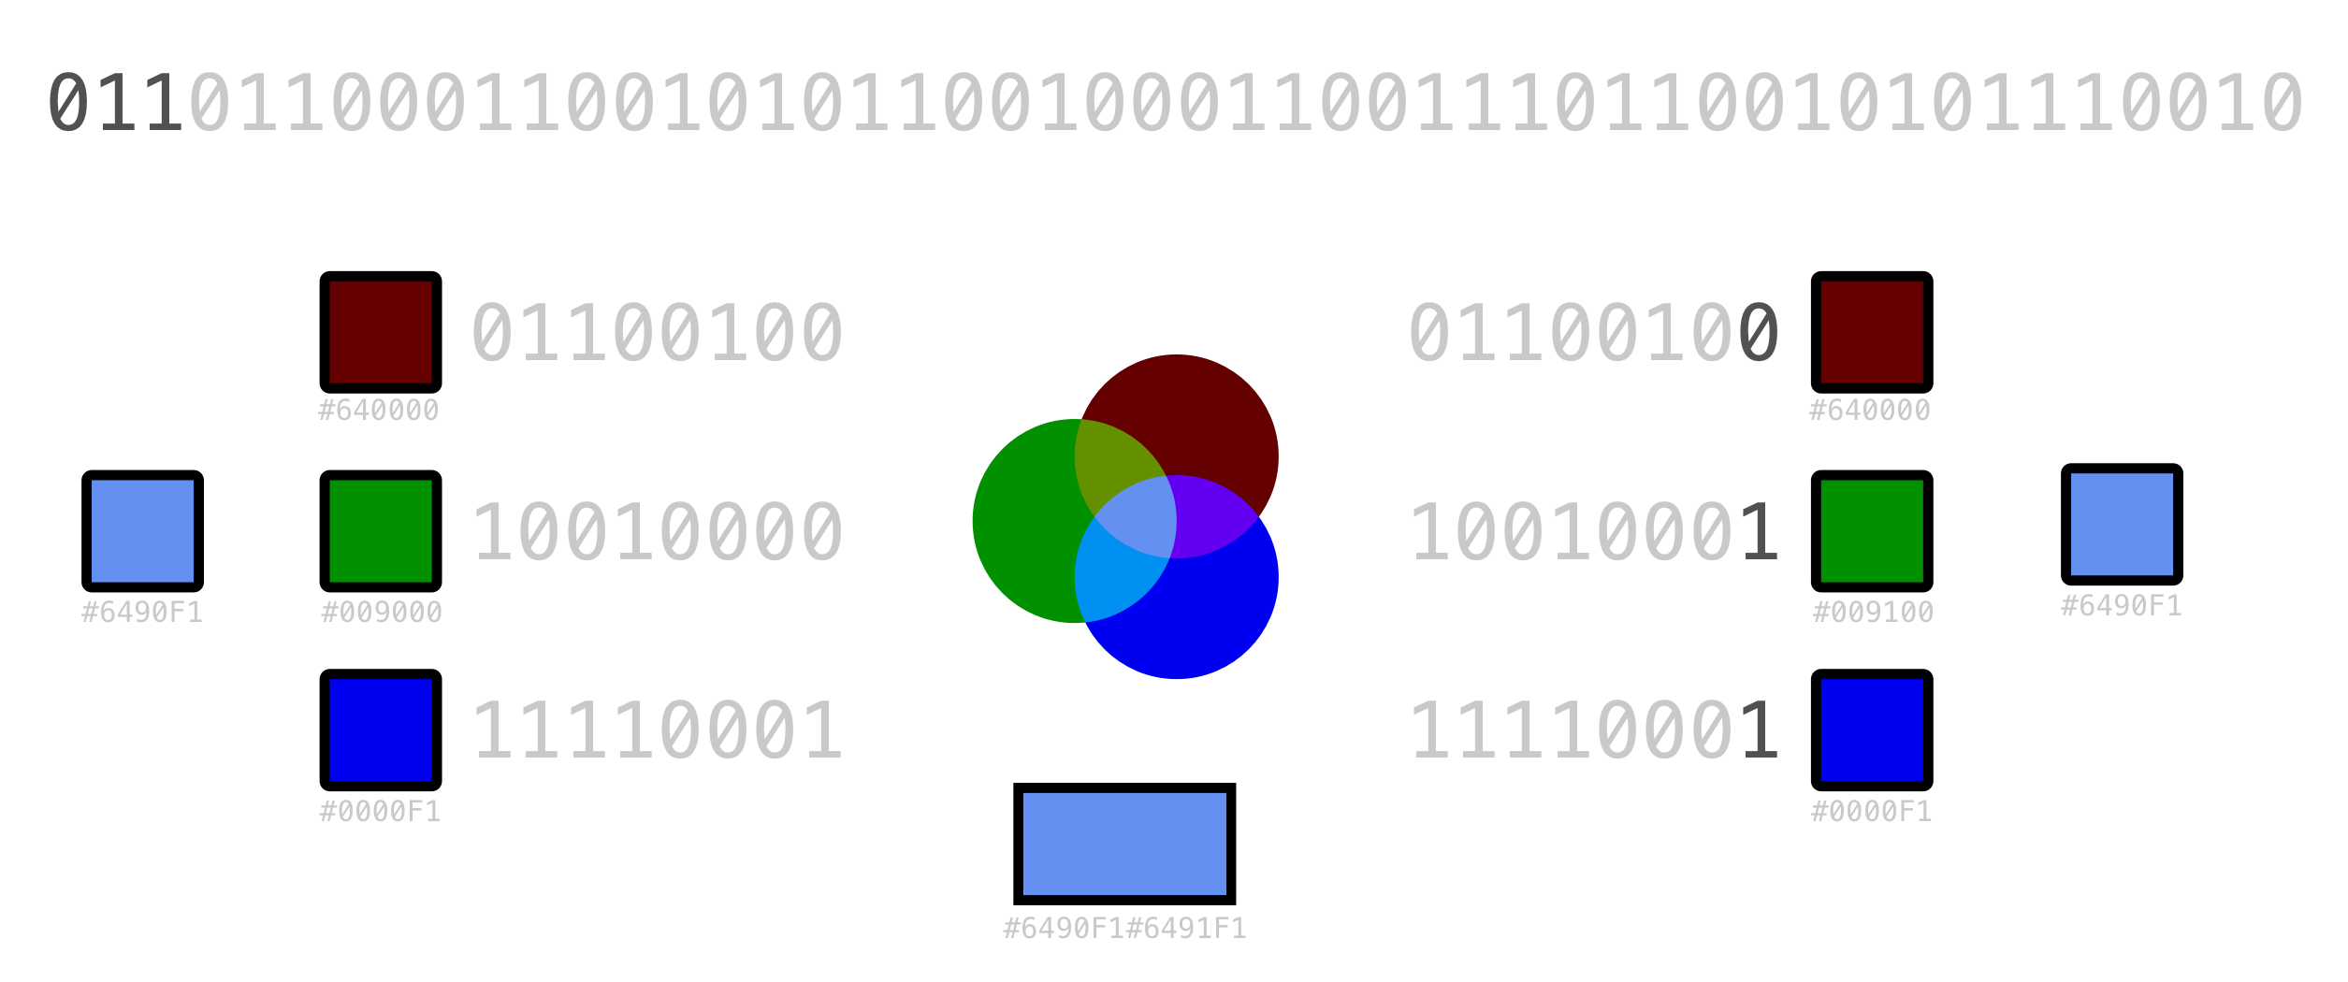
What is LSB?
Let’s say the code we wanted to hide was the text “Ledger” – the top of the photo is ledger in binary
The first 3 bits are 011, so we have to change the green byte in the first pixel from 0x90 to 0x91

Slide 7
Can’t we tell the difference then?
These are two different colors (so no)

Slide 8
Tools to do it
Doing it all by hand is ridiculous and would take too long
There are several different tools that can do it
Python script linked in GitHub
We’ll show a website that will do it + more
https://stegonline.georgeom.net/upload

Slide 9
(Do examples now)

Slide 10
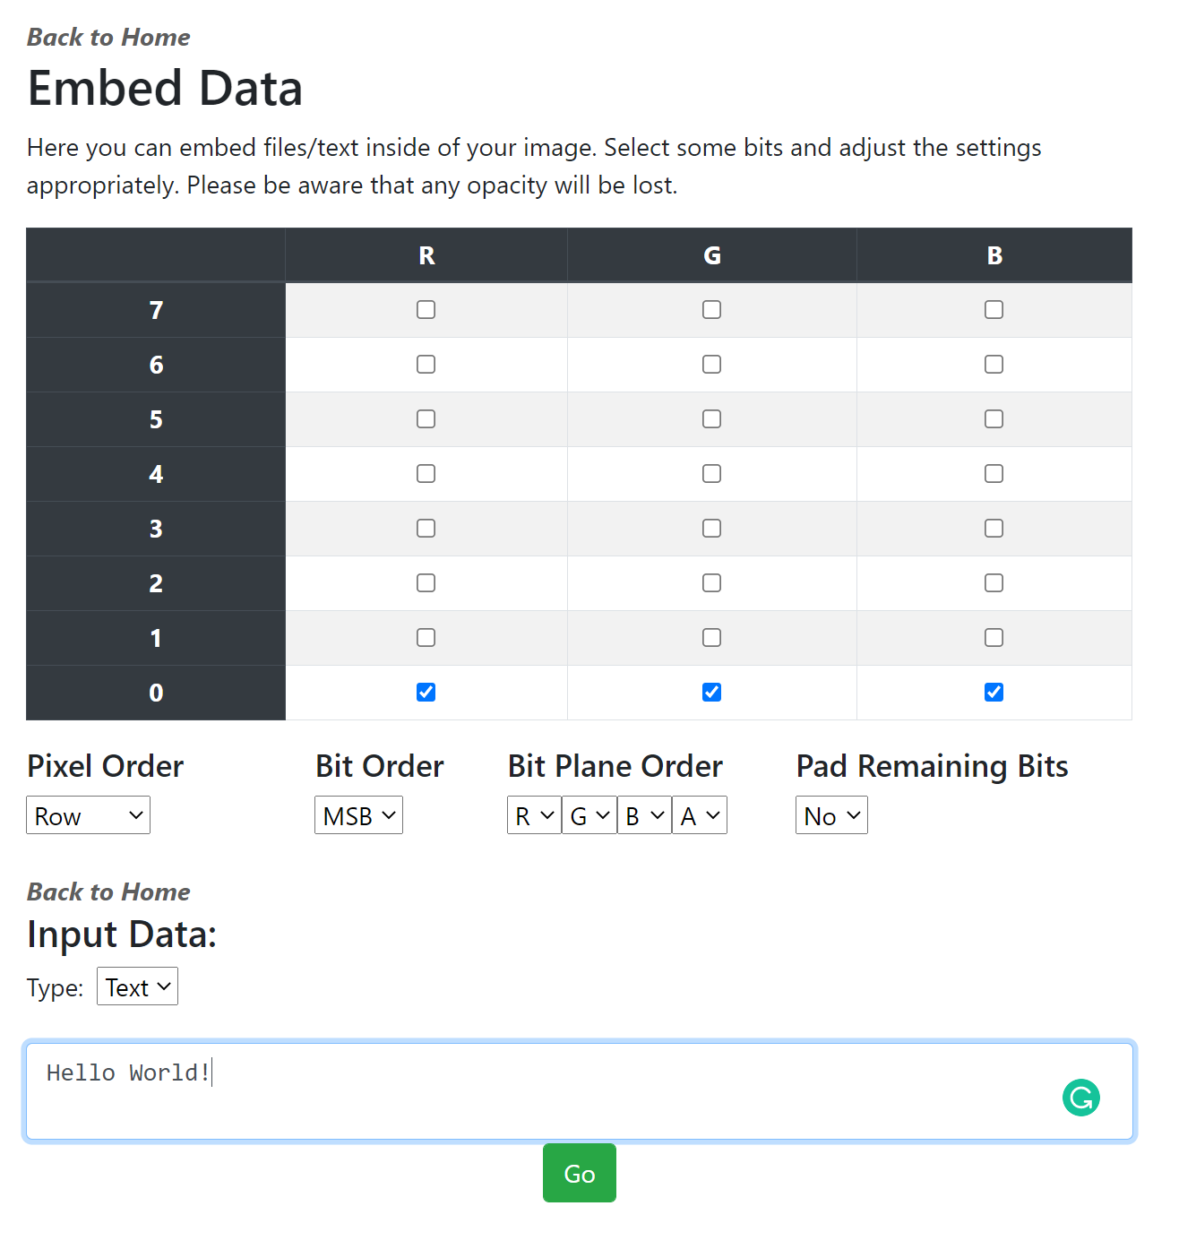
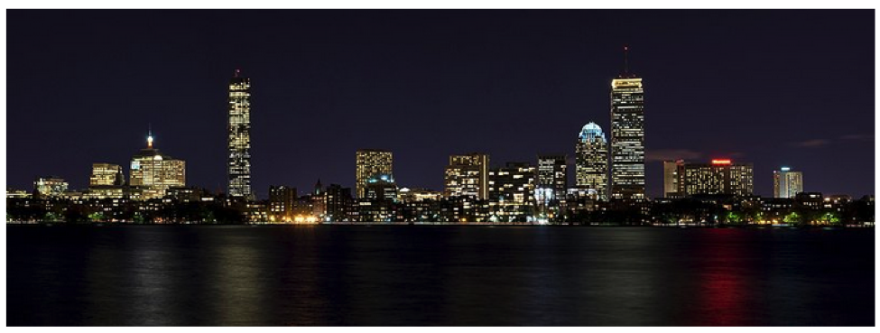
Before lsb data encoding

Slide 11
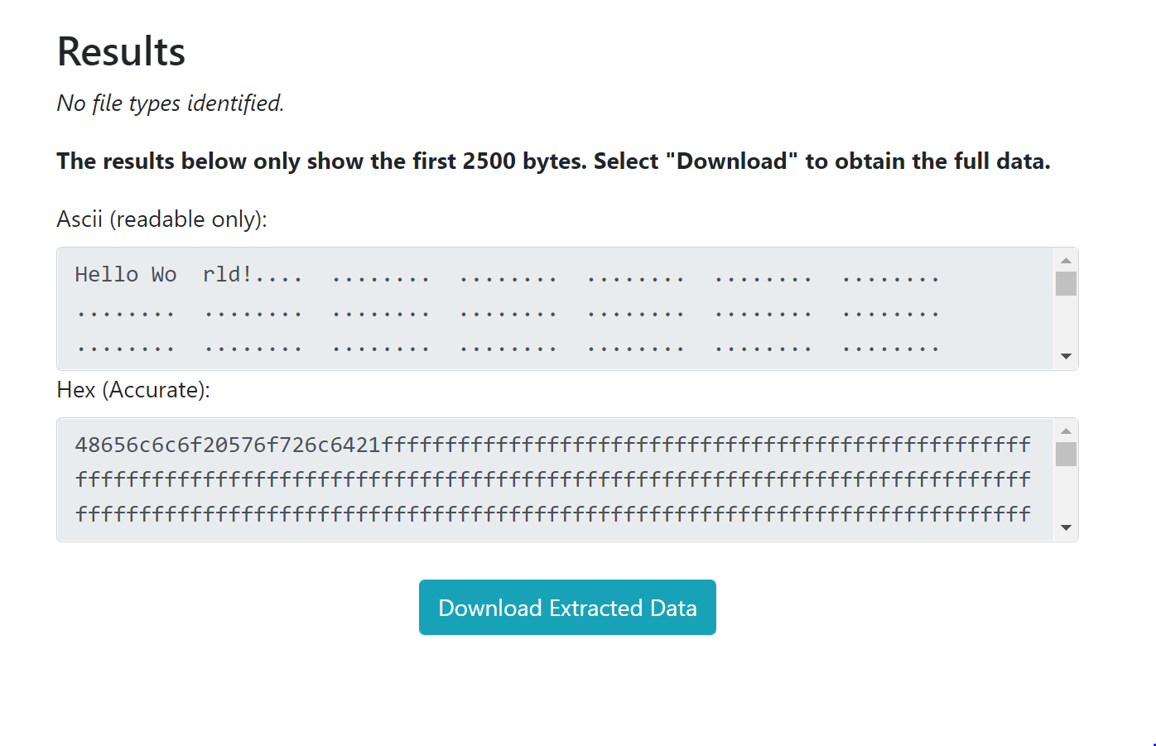
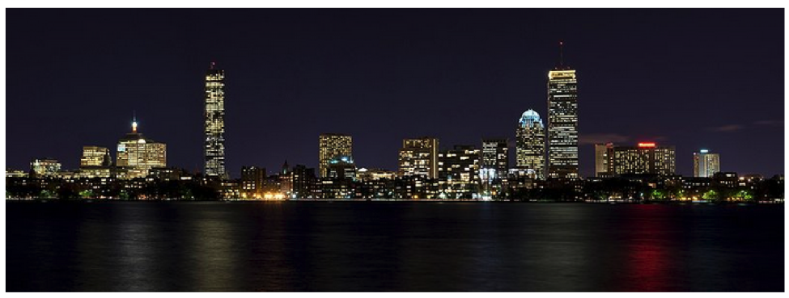
Before lsb data encoding

Slide 12
Variations of this method
What if each Least Significant Bit represented a black pixel or a white pixel? You could hide black and white photos in the LSB
What if we only hid it in the LSB of the RED pixels? Or green? (This is called a bit plane)
What if we used the TWO Least Significant Bits, instead of one? The change in color is more likely to be noticed, but we can fit more data in

Slide 13
How much data can I store this way?
For regular LSB, it’s 3 bits per pixel, so you would have (width)x(Height)x(3)/8 Bytes per photo. IE, a photo of 648x345 pixels can hide 83,835 Bytes, or 83 KB
Using the TWO LSB, you would have (width)x(height)x(6)/8. IE, a photo of 648x345 pixels can hide 167,670 Bytes, or 167 KB (twice as much)
Using only the Red LSB, you would have (width)x(height)x(1)/8. IE, a photo of 648x345 pixels can hide 27,945 Bytes, or ~28 KB (1/3 as much)

